Slide 1
IBM University Engagement Project Submission
“Exploring the Power of Agentic AI with IBM Granite and LangFlow”

Slide 2

Project Tile – Smart Study Generator Agent
Domain of Project – Education
Student Name | Recent Passport Photo | Email ID | Mobile number [WhatsApp]
Aditya Mahajan |  | mahajan2005aditya@gmail.com | 8432684549
Recommended font style and size: Font Style: Arial Font Size (Heading): 28
Font Size (Content): 20

Slide 3
Problem Statement -
Problem Statement : Social Media Agent
The Challenge
Brands, influencers, and organizations struggle to keep up with the fast-paced and fragmented world of social media. Content trends evolve hourly, audience sentiment shifts rapidly, and competitor strategies are difficult to track. Managing multiple platforms often leads to scattered insights, missed engagement opportunities, and ineffective campaigns. The challenge is not only to collect social media data but also to analyze, predict, and recommend actions in real time.
The Objective
Build an agentic AI application that acts as an intelligent social media companion. The solution should:
1.Fuse Multichannel Data :- Collect and synthesize content, comments, hashtags, and competitor posts from platforms like X, LinkedIn, Instagram, and Facebook into unified insights.
2.Enable Multimodal Interaction :- Accept user inputs (text, images, or voice prompts) and generate creative post drafts, captions, or campaign ideas aligned with brand tone.
3.Create a Predictive & Agentic Layer :- Forecast trending hashtags, audience sentiment shifts, and competitor engagement patterns while suggesting the best posting schedules.
4.Visualize Social Media Pulse :- Provide a dashboard with real-time analytics—engagement trends, influencer mapping, sentiment tracking, and campaign performance forecasts.

Slide 4
Proposed Solution -
Proposed Solution: Smart Study Generator Agent
The Smart Study Generator Agent is an AI-powered educational assistant that automatically generates personalized study materials from user-provided content such as PDFs, notes, textbooks, PowerPoint presentations, or topic names. The solution is built using IBM BOB (Builder on watsonx) with Langflow for designing the agent workflow and integrating multiple AI components.
Unlike a traditional chatbot that simply answers questions, this solution acts as an agentic AI system capable of understanding learning objectives, planning study content, retrieving information, generating learning resources, and continuously adapting to user requirements.
Working Process
Step 1: User Input
Step 2: Content Processing
Step 3: Intelligent Retrieval
Step 4: AI Study Material Generation
Step 5: Personalized Learning
Step 6: Continuous Interaction

Slide 5
Technology Used
IBM BOB (Builder on watsonx)- It provides Low-code AI agent development, Workflow automation, Integration with IBM Granite models, Agent orchestration, Tool calling, Deployment support.
Embedding Model- Converts text into vector representations.
Retrieval-Augmented Generation (RAG)- Provides More accurate responses, Reduced hallucinations, Document-grounded answers, Better factual correctness
Prompt Engineering- Carefully designed prompts instruct the LLM to generate: Educational content, Exams, Summaries Flashcards, Revision notes.
Optional Integrations- PDF Parser, OCR, Speech-to-Text, Text-to-Speech, IBM Cloud Object Storage, IBM Watson Discovery.

Slide 6
Langflow component Used -
1) Chat Input – Accepts user questions and uploaded content
2) Embedding Model - Converts text into embeddings
3) Name of IBM Granite model - Granite-4.0-8B-Instruct → Fast, efficient for real-time diet recommendations
4) Chat output -Displays generated study materials
5) File component - Stores and retrieves user data, meal logs, and nutritional datasets for analysis and tracking.
6) Output Parser - Formats responses

Slide 7
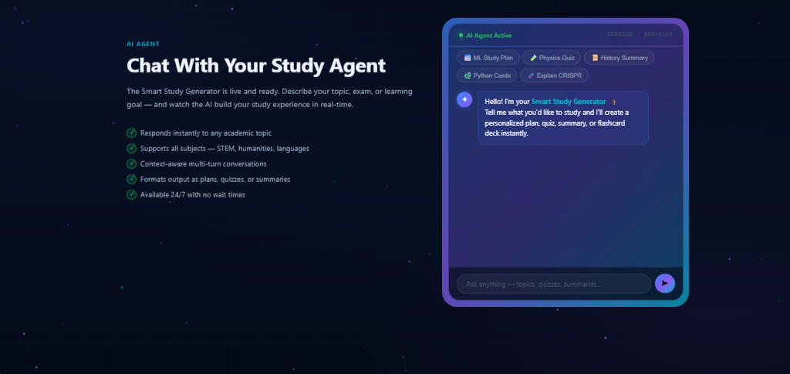
Screenshot of agent -

Slide 8

Role of Agentic AI in the solution
Role of Agentic AI in Smart Study Generator Agent
The proposed solution uses an Agentic AI architecture rather than a simple question-answering chatbot.
The agent performs autonomous reasoning and planning.
Responsibilities of the Agent :
Goal Understanding
The agent understands the student's objective.
Example:
"Prepare me for tomorrow's Operating Systems exam."
The agent determines:
important chapters
revision strategy
practice questions
expected exam pattern
Other responsibilities are Task Planning, Tool selection, Context Management, Decision Making

Slide 9
Novelty and Uniqueness
The Smart Study Generator Agent offers several innovative features that distinguish it from conventional AI learning tools.
Generates learning content based on:
learner level
uploaded notes
specific syllabus
examination pattern
Agent-Based Planning
Unlike static AI chatbots, the system autonomously plans study tasks and executes them in an organized sequence.
Visual Low-Code Development
Using Langflow and IBM BOB enables rapid development, easier maintenance, and extensibility without extensive coding.
Adaptive Learning
The agent customizes explanations and assessments according to the learner's proficiency and study goals.
Continuous Learning Assistance
The system supports iterative learning by remembering conversation context and allowing follow-up requests without requiring repeated explanations.

Slide 10
Git Hub Link
Please create public github repository (Enable Add README button while creating repository) with format –
Please test and Paste the working Github URL – https://github.com/Aditya8369/Smart-Study-Generator-Agent
·
·
·

Slide 11
Future Scope
The Smart Study Generator Agent can be expanded with several advanced capabilities.
Voice-Based Learning
Support voice interaction for asking questions and receiving spoken explanations.
Multilingual Education
Generate study materials in multiple regional and international languages.
AI Tutor Mode
Provide step-by-step teaching, hints, and adaptive guidance similar to a personal tutor.
Offline Mobile Application
Develop Android and iOS applications with offline access to downloaded study materials and quizzes.
·
·
·

Slide 12
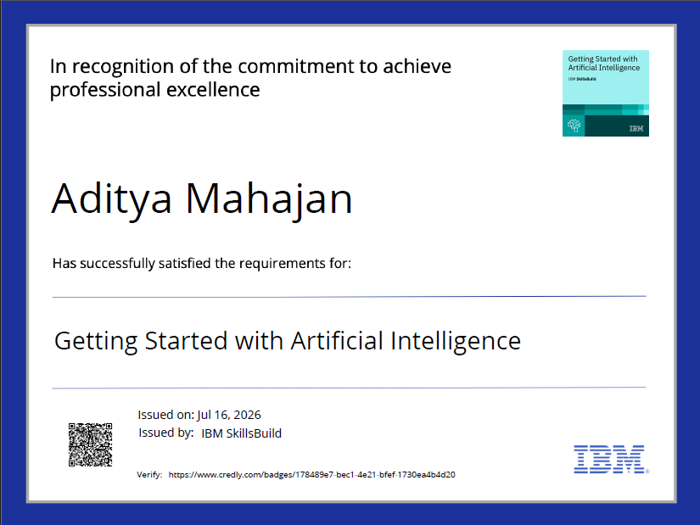
Certificates Earned:
Please add your credly certificate

Slide 13
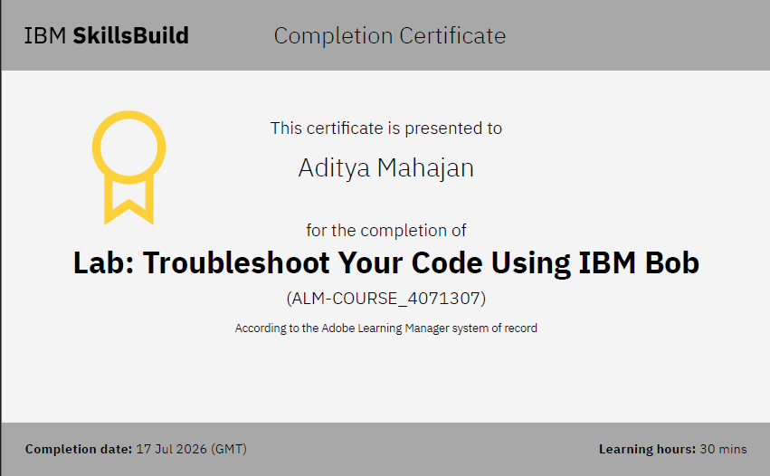
Certificates Earned:​
Add your IBM BOB Certificate

Slide 14


